Slide 1
Operating Systems for Computer Clusters

Slide 2
Functions of the OS of a HPC Cluster
Provisioning computing nodes (installing/updating OS on computing nodes) (xCAT)
Management of the computing resources of the cluster (PCM)
Workload management (job/task scheduling) (Platform LSF)
Distributed file system (GPFS, NFS)
Hardware management and system monitoring (PCM)
Scalability (PCM)

Slide 3
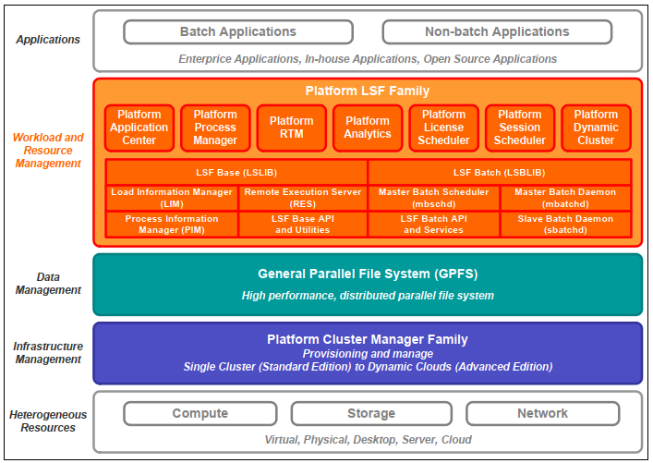
HPC Cluster layered architecture

Slide 4
IBM PCM – Platform Cluster Manager
Manages the resources of the cluster (using xCAT as provisioning engine)
Provides system monitoring and reporting
Has centralized web portal
Provides remote control of compute nodes

Slide 5
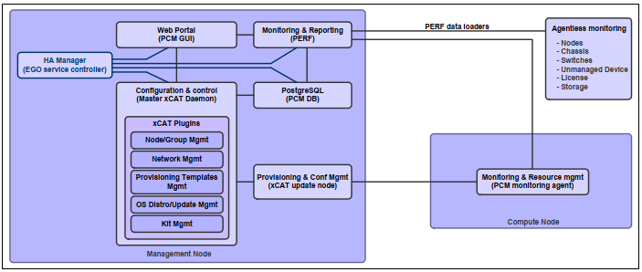
IBM PCM component architecture

Slide 6
xCAT – Extreme Cloud Administration Toolkit

Slide 7
xCAT usages
Discover the hardware servers
Execute remote system management
Provision operating systems on physical or virtual machines
Provision machines in Diskful (stateful) and Diskless (stateless)
Install and configure user applications

Slide 8
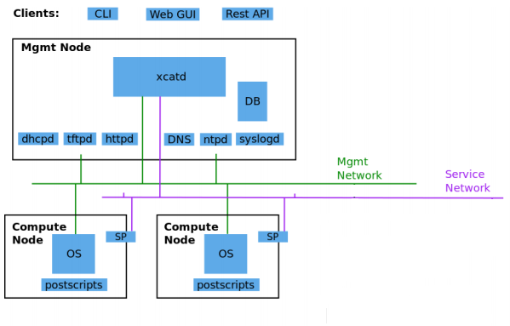
xCAT architecture

Slide 9
xCAT architecture (cont.)
Mgmt node: management node, server where XCAT is installed and which is used as a single point in managing the cluster; nodes are defined in postscript database
Compute node: a compute node from the clusted which is managed by xCAT
Network services (dhcpd, tftpd, httpd, dns, ntpd, syslogd) : used for managing the cluster nodes, automatically configured
Service Processor (SP): embedded system in the server hardware, used to perform out-of-band hardware control (IMM –Integrated Management Module for IBM, iLo for HP, iDRAC for DELL)
Management network: used to provision/install compute nodes
Service network: used by the management node to control the SP on the nodes

Slide 10
Start/stop the xcatd service
service xcatd { stop | start | restart | status }

Slide 11
Platform LSF
LSF = Load Sharing Facility
is job scheduling engine
manages hardware resources and job requirements and finds the best execution plan
monitors job execution progress
has multiple job queues with several scheduling policies in the same cluster: FCFS (First Come First Served), Service Level Agreement (SLA) scheduling, Fairshare scheduling
allows resource reservation
allows resizable jobs

Slide 12
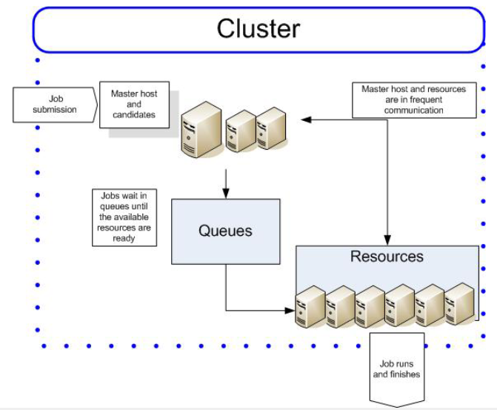
Job Processing with LSF

Slide 13
LSF Architecture
LSF Base: provides load sharing services (resource usage information, process information host selection, remote execution)
    Load Information Manager (LIM): LIM on a host monitors the host’s load and reports it to the LIM running on headnode which provides the info to apps.
    Process Information Manager(PIM): runs on each host, collects info about job processes and reports them to sbatchd
    Remote Execution Server (RES): runs on each hosts and executes tasks on that host
LSF Batch: provides job execution with load balancing and policy driven resource usage
    mbschd (Master Batch Scheduler daemon): runs on headnode, receives job submissions, maintains queues, job status, dispaches jobs on compute nodes for execution
    sbatchd (Slave Batch daemon): runs on each host, receives jobs from mbschd, creates a child sbatchd for each job, gives the job to RES in order to execute it
LSF Libraries: provides API for interfacing with LSF

Slide 14
LSF – view daemon parameters
Show mbatchd conf. : badmin showconf mbd
Show sbatchd conf. on host: badmin showconf sbd host
Show lim conf. on host: lsadmin showconf lim
Summary: badmin showstatus

Slide 15
IBM GPFS - General Parallel File System
shares NSDs (Network Storage Disks) between the hosts of a GPFS cluster
the data access is done at block level (not at file level)
a NSD can be created from a local hard disk drive, from several local hard disk drives (connected in RAID or as a multipath device) or from the partitions/LUNs (Logical Unit Number – an ID of a storage device in a SCSI environment)
the NDSs are exposed to the hosts computers in the GPFS cluster by NSD servers.

Slide 16
UBB’s IBM Intelligent Cluster (2016)
HPC Cluster + Cloud System
Built by IBM (costed approx. 1 mil. EUR, without VAT)
Consists of: 4x 42U computing racks, 4x cooling rack(+exterior unit), 2 UPS enclosures
Performance: Rpeak 62 Tflops (theoretical), Rmax 40 Tflops

Slide 17
UBB’s IBM NextScale (HPC Cluster)
68 Nx360 M5 computing nodes
  50 nodes: 2x Intel Xeon E5-2660 v3 CPU, 10 cores; 128GB RAM; 2 HDD SATA 500 GB
  12 nodes with 2 Nvidia K40X GPU
  6 nodes with Intel Phi
Fast networking: 56 Gb/s (Infiniband Mellanox FDR switch SX6512 with 216 ports, 1:1 subscription rate)
Storage: IBM GPFS (General Parallel File System) NetApp E5660 Total: 72TB
Backup: IBM TS3100 Tape library
Mgmt. Software: IBM Platform HPC 4.2 and RedHat Linux Enterprise 7.2 for comp. nodes
Others: 2 management nodes, 2 NSD, Fast Ethernet switches

Slide 18
UBB’s IBM Flex System (Cloud System)
10 virtualization servers Flex System x240
  128 Gb RAM / server
  CPU 2 x Intel Xeon E5-2640 v2 / server
  HDD 2 x SSD SATA 240 Gb / server
1 management server
Cloud Software: IBM cloud manager with OpenStack 4.2
Management and Monitor Software: IBM Flex System Manager software stack
Virtualization Software: Vmware vSphere Enterprise 5.1

Slide 19
Cluster application software
Inter Parallel Studio
Matlab
Mathematica
Lumerical FDTD
Ansys
Comsol
Multiphysics Gaussian
Material Studio
…

Slide 20
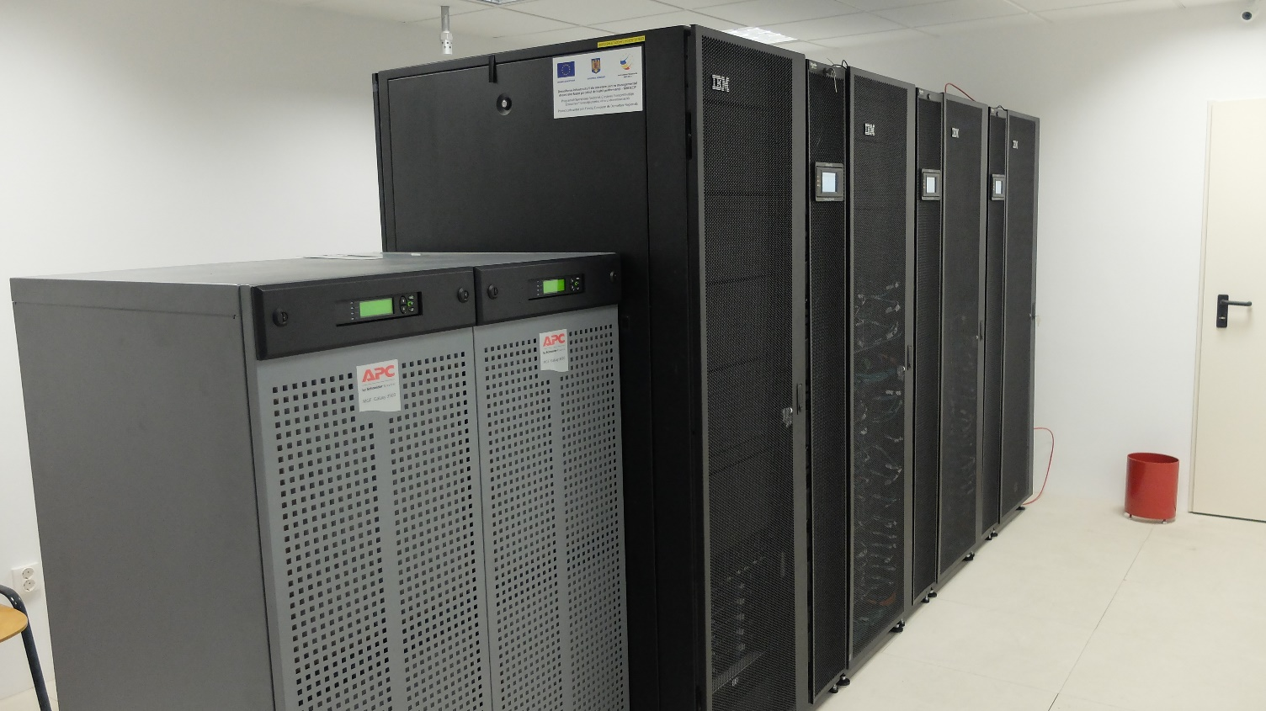
Cluster physical view
managed by Faculty of Mathematics and Computer Science & Faculty of Economic Studies

Slide 21
IT Architecture for HPC and Private Cloud Computing
CMwO Self Service Portal - Enduser
(XML)
HPC Portal - Enduser
(job submision, files upload and reporting)
Storage
DCS3700
Inteligent Cluster
Virtualization Resource Pool
Flex System Ent.
HPC Resource Pool
NextScale
CMwO Admin
Self Service
SLA Management
Metering
Accounting
Image Provisioning
vCenter
Cluster Manager
Cloning
Provisioninig
Syslog
vSphere Management
Head Nodes
(HPC Management and
LSF)
Management
Ethernet
Network
GPFS
LUN‘s
Various VM‘s and vApp‘s
GPFS Cluster
(NSD)
MPI/RMA
IB Network
Backup Software
Tape Library Management
Flex
LUN‘s
Flex Chassie
NextScale Compute Nodes
Management
Node
Management
Node
Compute
Node
Compute
Node
10GE Network
Compute
Node
Compute
Node with GPU
Compute
Node with Phi
Compute
Node
Compute
Node
16Gbps FC Network
Backup
Tape
Compute
Node
Compute
Node
Backup
Node
Compute
Node
Chassies MNG
Module
Compute
Node
Compute
Node with GPU
Compute
Node with Phi
TS3100

Slide 22
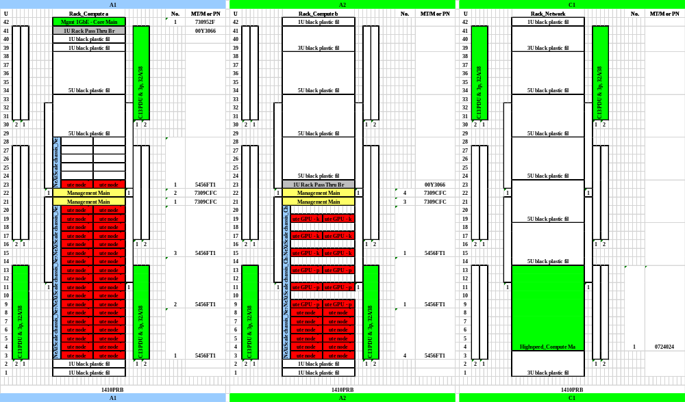
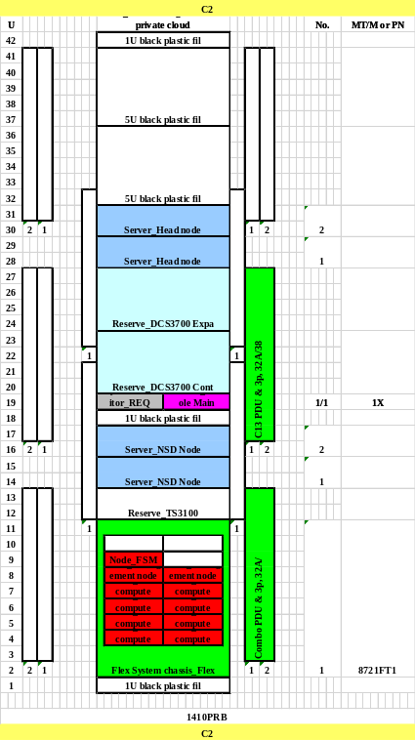
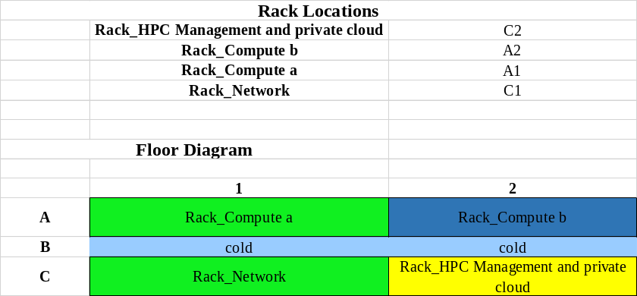
IBM Intelligent Cluster - Rack and floor view

